Slide 1
World Day of Prayer
Guiding Principles for group conversation
Prepared by WDPIC

Slide 2
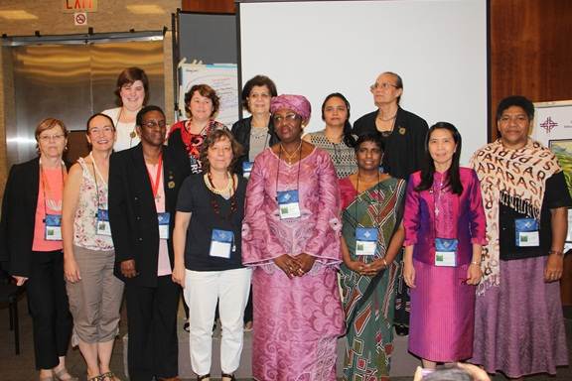

Who are we?
A worldwide ecumenical movement led by Christian who welcome all to join for informed prayer and prayerful action for peace and justice
    Intergenerational
    Multicultural, multi-ethnical, multi-language
    Various Christian traditions
    Open to all
    Common day of prayer – first Friday of March
    Continuing relationship of prayer and service
    Organized for peace and justice
    Fellowship, movement, network, partnership, collaboration – open circle
    Share stories and stand in solidarity

Slide 3
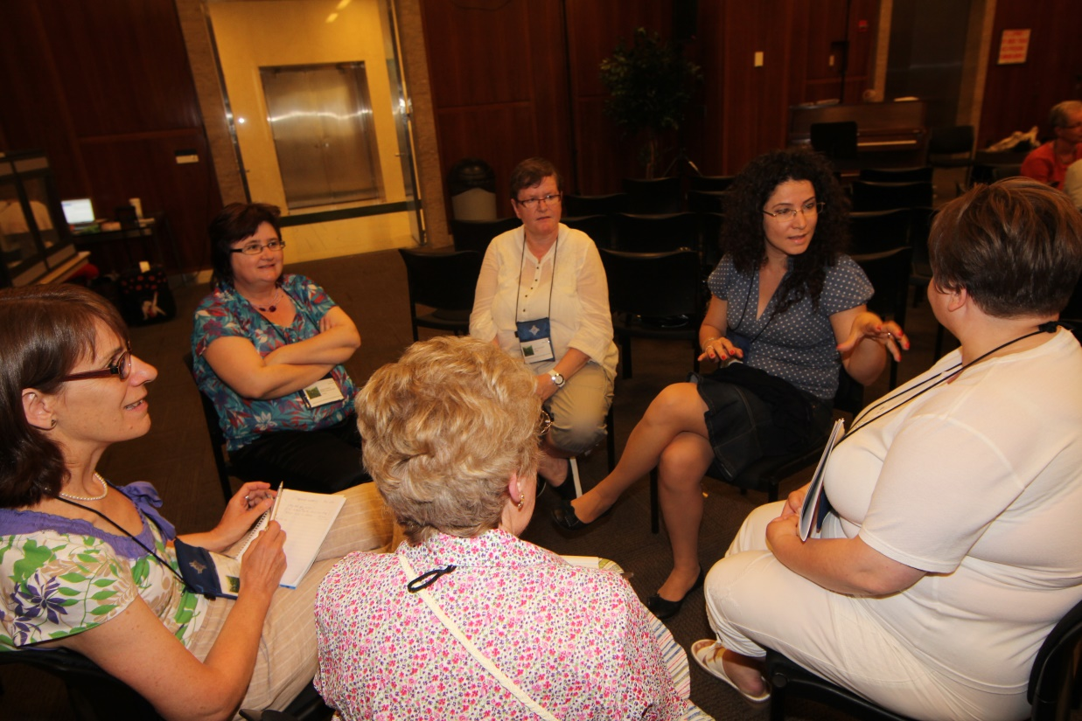
What guide us together in the World Day of Prayer?

Slide 4
Orientation
Form 9 groups
Give each group one Guiding Principle and the 2 questions
Ask each group to report the conversation creatively and with practical ideas.
Conclude the session with the prayer on the last slide.

Slide 5

1. Starting point: Christian Women.
We recognize Christian women as competent to express their faith and to speak about their lives in prayer and worship before God and in community.
Christian women see themselves and one another as Christians before God coming from different theological and church traditions in which they respect one another.
They turn to their faith in Jesus Christ and to the Bible as a common basis from which to shape their prayer and worship

Slide 6
Talking points
Can women speak on behalf of their faith? Is there any limit to that?
Share your experiences about women building respectful relationship in the midst of theological and tradition diversity within WDP.

Slide 7
2. Listening and speaking
Prayer is rooted in listening to God and to one another. On World Day of Prayer we listen to the Word of God and to voices of women sharing their hopes and fears, their joys and sorrows, their opportunities and needs.
In a climate of attentive listening, women find their voices and can speak from their experiences. We can “hear one another into speaking”.
The commitment to speak and to listen provides the basis for genuine dialogue.
Dialogue in WDP takes place between women far apart from one another and among women at home. The voice of far away women is primarily received in written form and asks us for creative ways for how we can enter into dialogue with them. Careful preparation of the WDP service is necessary to enable local communities to join their voices in informed prayer on the first Friday of March.

Slide 8
Talking points
How do you exercise listening to each other in your community, and listening from afar through the WDP worship service material?
Share your ideas of your careful preparation for engaging the local community in the ‘informed prayer’.

Slide 9
3.Being faithful and creative
WDP calls women to be faithful to the worship service that they receive and to the women who wrote it.
Within the demands of translation into different languages and interpretations into different contexts women strive to be faithful to the texts that they received and so to make heard the voices of women of a different country.
Faithful listening also opens our eyes and leads to creativity in building a bridge between different contexts.
WDP encourages creative celebration of the WDP service which expresses your own response to the theme, the bible texts, and the points of connection between women in different parts of the world.
Faithful creativity in celebrating WDP widens the horizons of all who participate. It fosters vital ecumenical prayer and strengthens ecumenical solidarity at the local level and worldwide.

Slide 10
Talking points
How does the WDP National Committee engage with the Worship Service?
Share how creatively your group build the bridge between your context and the worship service context.

Slide 11
4. Stretching beyond what is familiar;
becoming inclusive.
It takes some risk to understand one another from where the other person is rather than from where I am;
Stretching asks us to move through our own resistance and to overcome obstacles and to cross borders.
It brings renewal when there is stretching out to far away women and to those who live nearby and to new generations of young women.
To be inclusive offers the possibility to encounter the breadth and depth of the Christian experience.

Slide 12
Talking points
What are the borders you have crossed in your life motivated by your WDP experience?
Share the renewal young women have brought to WDP in your community

Slide 13
5. Sharing acknowledges that all have something
to give and to receive
Each year the women of a country share their faith and lives in the worship service with their sisters around the world.
Taking turns in writing the service emphasizes that all are able to give and receive.
In sharing prayers, culture, music, art, we discover commonalities and differences that can be celebrated and can be enriching.
Sharing resources has many expressions: gifts, talents, skills, hospitality, care, time, commitment, reliability, persistence, and other forms of assistance.
Through the WDP offering women share their resources with women and children around the world.

Slide 14
Talking points
How much does a Committee give and receive when writing a service?
Share about the commonalities, resources and gifts you have discovered within the WDP community. How do you offer them to the world?

Slide 15
6. Developing global ecumenical sisterhood; building trust with one another
We begin on a personal level with respect and being open-hearted.
This openness helps to establish relationships which make further steps possible.
In an atmosphere of trust barriers that divide can be overcome.
God’s trust in us enables and encourages us to trust one another.
Trust is also a key attitude in building authentic ecumenical relations.

Slide 16
Talking points
How have you built trust in this ecumenical sisterhood?
Share about the relationships you build through WDP.

Slide 17
7. Being a Christian neighbor in a multi-religious world
Our prayer on WDP is Christian prayer taking place in a multi-religious world.
Called by Jesus Christ to love our neighbors, Christian women seek to live in community with everyone around them including people of other faith traditions.
While today the search for ways to hold inter-faith prayer is happening on various levels, WDP is keeping its focus on strengthening ecumenical relationships through Christian prayer.
If people of other faiths wish to attend WDP services or women wish to invite neighbors of other faiths, they are welcome as guests to whom we extend Christian hospitality.

Slide 18
Talking points
How multi-religious is your world?
Share how you love your neighbor and offer Christian hospitality.

Slide 19
8. Committed to learn; striving for wisdom
Each year WDP brings to women a stimulus to learn and to study. Women welcome the occasion to reflect on the significance of the annual WDP theme and to learn about the lives of people in other countries. They are keen to discover new understandings about cultures, expressions of Christianity, causes for social problems, urgent world issues, ways to address them, etc.
WDP furthers an attitude of learning that is open to new perspectives and that helps to grow a body of knowledge that can build on the years before.
WDP fosters the use and development of appropriate educational materials that range from written texts to new media.

Slide 20
8. Committed to learn; striving for wisdom
WDP understands learning as a mutual process of learning together and from one another. Together we strive for wisdom that shapes our understandings and guides our actions in our daily lives.
  WDP helps us to recognize better what is our own and to appreciate and respect what is other than our own. To differentiate is an important part of our learning process. Thus we build a global perspective that resembles a rainbow of many colors and that is different from forces that drive “globalization” in a way that devalues people’s lives and cultures.
  Each year the WDP theme and worship service take up a different aspect of Christian theology in an ecumenical endeavor. Thus WDP contributes to ecumenical learning and a fuller understanding of our Christian faith.

Slide 21
Talking points
What have you learned with the annual theme and people’s lives brought to you by WDP worship service and resource material?
Share ideas to foster the mutuality in the learning process and to strive for wisdom.

Slide 22
9. Moving into responsible action
In WDP every woman is invited to be engaged and to bring in her talents. All the time, skills, services that are contributed; all the study undertaken and all the trust that is being built become the basis for ongoing action. This active participation takes up the WDP motto: informed prayer--prayerful action. We need the depth of prayer and meditation so we can freely risk ourselves in love and action.
WDP encourages responsible action that grows out of the worship service and its theme, and that is wisely discerned and appropriate for the women who engage in it.

Slide 23
9. Moving into responsible action
The steps toward action begin wherever women are in their everyday lives in their communities and can reach as far as the everyday lives of women in other countries.
When women move forward step by step they express both courage and hope. Being willing to look at the problems that affect the world and cause suffering requires courage. To take small steps and proceed one step at a time is an expression of hope even when confronted by many difficulties.
WDP has grown from small seeds into a global ecumenical movement, a tree that grows every year. The trust that we have is in God who gives the seeds the strength to grow and the tree to bear fruit. God empowers us on our journey as we walk step by step with one another.

Slide 24
Talking points
What does it mean ‘informed prayer and prayerful action’?
Share about an action that grew out of the worship service and theme that your WDP community had engaged in.

Slide 25
God, source of our strength,
We thank you.
You transform the seed into fruit,
You feed and sustain us,
You are with us on easy and difficult paths
You enable us to walk with one another
We ask you,
Help us trust your strength that cares for what is small
And that can create something marvelous from timid beginnings
Be near us, guide and move us.
As the grains from many fields become bread
So make out of us one community
Sign of hope in this world. Amen.

